Slide 1

MEDIATOR DESIGN PATTERN
how to simplify your code and handle cross-cutting concerns using mediatr library

Slide 2

Code and extra materials
https://github.com/vesou/MediatRDemo
https://github.com/jbogard/MediatR/wiki
Code Opinion YT - https://www.youtube.com/watch?v=ngeEYUy9hI8
Jonathan Williams YT - https://www.youtube.com/watch?v=mdzEKGlH0_Q
Nick Chapsas YT - https://www.youtube.com/watch?v=2JzQuIvxIqk
Notes:
- strongly suggest to follow some of those YouTube channels as it's a decent place to get the latest info from

Slide 3
Agenda
problems with a standard way of building WebApi in .NET
.NET framework approach to fixing big and clunky Controllers
introduction to Mediator design pattern
handling cross-cutting concerns
speed and memory concerns
Extra – “outOfProcess” solution – leveraging “Hangfire” library

Slide 4
What this presentation is not about
Command and Query Responsibility Segregation (CQRS)
Vertical Slices Architecture
MediatR supports 3 different messaging strategies
Pub/sub approach – .Publish()
Streaming of IAsyncEnumerable - .CreateStream()
Notes:
- CQRS - mediator supports it by convention (Query and Command being added into the Request Names) and even encourages it but does not enforce it
- Vertical Slices – similarly it is fully supported, but that focuses more on separation of concerns between whole slice and not between layers
- Pub/Sub – done in processes so probably shouldn’t be used for EventMessaging between services so maybe just for Internal Events
- Streaming – very good but not part of this talk

Slide 5
So what is it about?
One-to-one mapping – Request/response – using “.Send()” method
Notes:
A simple one to one mapping between request-handler-response

Slide 6
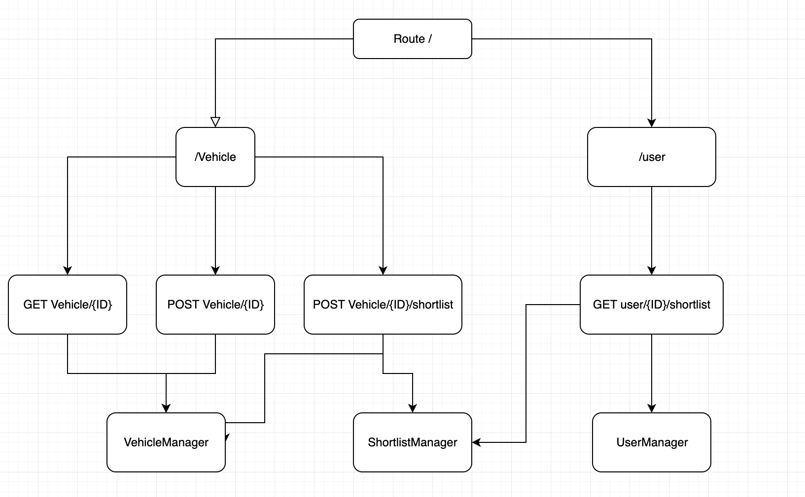
Standard approach
Domain Driven Design dictates how well this approach will work over the coming months of developing a new solution
Notes:
- depending on how good you are designing your domain objects sometimes this may lead to a single controller that has to have access to multiple repositories, services or managers
- it’s a big file of mostly unrelated methods – most of them don’t need to know about the dependencies of other methods

Slide 7
Design Problems with standard approach
Extending functionality – Open/Close Principle
Interface Segregation Principle
Single Responsibility Principle
Notes:
- open/close principle – adding new route may force you to add a new dependency or maybe even add a new strategy that will require you to change other endpoint to continue on working
- Interface Segregation Principle – even though there is no interface on this you can see how it forces you into bundling together multiple unrelated methods
- single responsibility? – manage HTTP Context for a particular root route

Slide 8
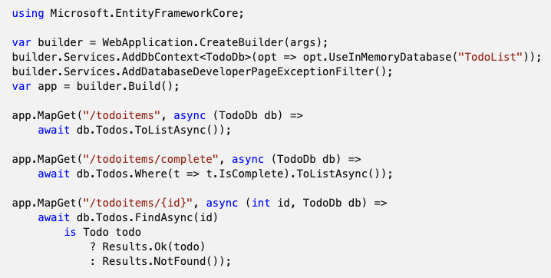
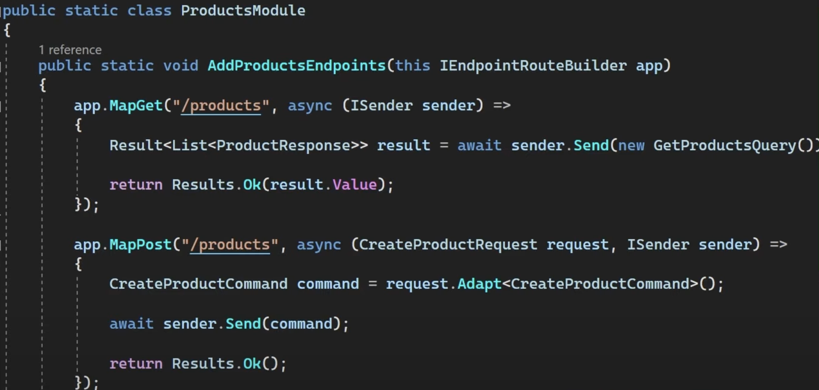
Current framework solution
Minimal api’s
File per route / endpoint approach
Single file approach
Notes:
- Minimal API's
- single file - not suitable for any larger developments - good for POC or prototyping
- multiple files with extension methods - better but has it's own limitations
-- needs to create many extension methods
-- or reflection

Slide 9
Solution…
Let’s add an intermediary

Slide 10
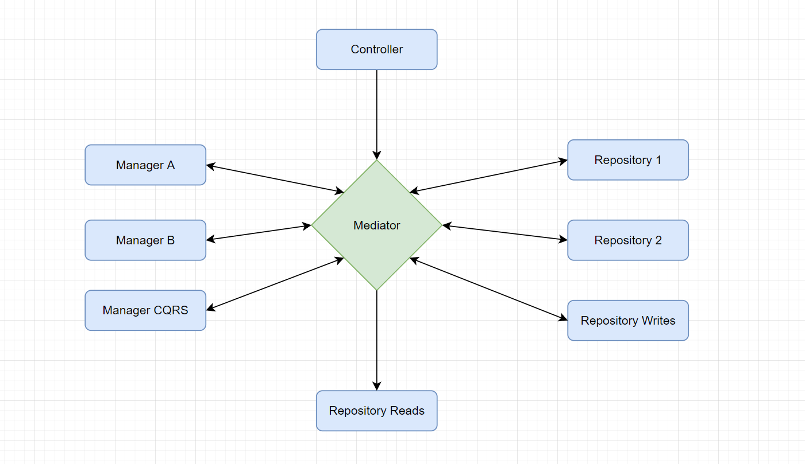
Mediator design pattern
Notes:
kind of a big dictionary that maps the request to a selected handler
Any one can use mediator to send requests to others

Slide 11
Simple mediator implementation
Let’s jump into the code
Notes:
replace service/manager logic with a specific Handler
drawbacks
more files
finding correct handler from the caller (controller) - discoverability
fixing the problem with finding handler - refactor request into the same file
benefits
only required service registrations
much smaller file focused on a single behaviour/action

Slide 12
Implementing Cross-cutting concerns
the real game changer – pipeline behaviours
Notes:
- did you ever had to add a common functionality between a set of endpoints?
- .net middlewares
- or decorator design pattern
- logging, gathering metrics, validation, cacheing?

Slide 13
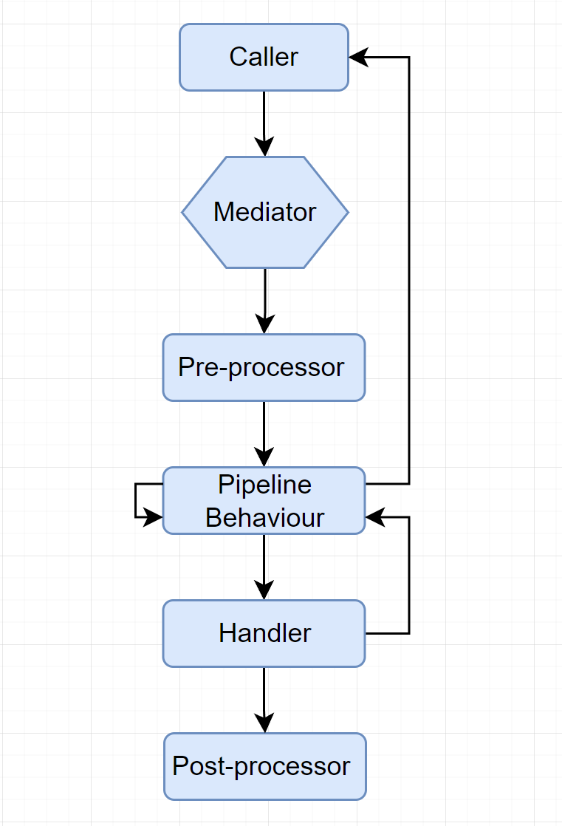

Slide 14
Pipeline Behaviour implementation
Let’s jump into the code

Slide 15
Speed and memory concerns
Is it really that slow?
Video to watch for those interested in more stats https://www.youtube.com/watch?v=baiH3f_TFfY
Notes:
- the speed impact is negligible in most of the cases when looking at a real world API
- the higher memory consumption is more impactful in a highly memory restricted scenario as it causes more often GC
– like inside a Kubernetes pod, but still negligible in my opinion

Slide 16
Implementing Out of process solution
Using hangfire to run tasks outside of http context
Notes:
If you need a simple way of returning to the user quickly and processing in the background
Hangfire is a very simple to use library helping with running tasks
Automatic retry and back-off
Able to select specific runners
Nice UI out of the box

Slide 17
Q&A

